Slide 1
Data Mining: Concepts and Techniques (3rd ed.) — Chapter 10 —
Jiawei Han, Micheline Kamber, and Jian Pei
University of Illinois at Urbana-Champaign &
Simon Fraser University
©2011 Han, Kamber & Pei. All rights reserved.
Notes:
1

Slide 2
Chapter 10. Cluster Analysis: Basic Concepts and Methods
Cluster Analysis: Basic Concepts
Partitioning Methods
Hierarchical Methods
Density-Based Methods
Grid-Based Methods
Evaluation of Clustering
2
2
Notes:
2

Slide 3
What is Cluster Analysis?
Cluster: A collection of data objects
similar (or related) to one another within the same group
dissimilar (or unrelated) to the objects in other groups
Cluster analysis (or clustering, data segmentation, …)
Finding similarities between data according to the characteristics found in the data and grouping similar data objects into clusters.
Classification is supervised learning while clustering is unsupervised.
Unsupervised learning: no predefined classes (i.e., learning by observations vs. learning by examples: supervised)
Typical applications
As a stand-alone tool to get insight into data distribution
As a preprocessing step for other algorithms

Slide 4
Applications
Cluster analysis has been widely used in many applications such as
business intelligence(BI),
image pattern recognition,
Web search,
biology, and
security.
In business intelligence,
clustering can be used to organize a large number of customers into groups, where customers within a group share strong similar characteristics. This facilitates the development of business strategies for enhanced customer relationship management. Moreover, consider a consultant company with a large number of projects. To improve project management, clustering can be applied to partition projects into categories based on similarity so that project auditing and diagnosis (to improve project delivery and outcomes) can be conducted effectively.

Slide 5
Applications…
In image recognition,
clustering can be used to discover clusters or “subclasses” in handwritten character recognition systems.
Suppose we have a data set of handwritten digits, where each digit is labeled as either 1, 2, 3, and so on.
Note that there can be a large variance in the way in which people write the same digit.
Take the number 2, for example. Some people may write it with a small circle at the left bottom part, while some others may not. We can use clustering to determine subclasses for “2,” each of which represents a variation on the way in which 2 can be written. Using multiple models based on the subclasses can improve overall recognition accuracy.

Slide 6
Applications…
Clustering has also found many applications in Web search.
For example, a keyword search may often return a very large number of hits (i.e., pages relevant to the search) due to the extremely large number of web pages.
Clustering can be used to organize the search results into groups and present the results in a concise and easily accessible way.
Moreover, clustering techniques have been developed to cluster documents into topics, which are commonly used in information retrieval practice.

Slide 7
Applications…
clustering is sometimes called automatic classification.
Clustering is also called data segmentation in some applications because clustering partitions large data sets into groups according to their similarity.
Clustering can also be used for outlier detection
Applications of outlier detection include
the detection of credit card fraud and the
monitoring of criminal activities in electronic commerce.

Slide 8
Clustering for Data Understanding and Applications in areas for research
Biology: taxonomy of living things: kingdom, phylum, class, order, family, genus and species
Information retrieval: document clustering
Land use: Identification of areas of similar land use in an earth observation database
Marketing: Help marketers discover distinct groups in their customer bases, and then use this knowledge to develop targeted marketing programs
City-planning: Identifying groups of houses according to their house type, value, and geographical location
Earth-quake studies: Observed earth quake epicenters should be clustered along continent faults
Climate: understanding earth climate, find patterns of atmospheric and ocean
Economic Science: market research.

Slide 9
In data mining, efforts have focused on finding methods for efficient and effective cluster analysis in large databases.
Active themes of research focus on the scalability of clustering methods, the effectiveness of methods for clustering
complex shapes (e.g., non-spherical, arbitrary shapes)
types of data (e.g., text, graphs, and images),
high-dimensional clustering techniques (e.g., clustering objects with thousands of features), and
methods for clustering mixed numerical and nominal data in large databases.

Slide 10
Clustering as a Preprocessing Tool (Utility)
Summarization:
Preprocessing for regression, PCA, classification, and association analysis
Compression:
Image processing: vector quantization
Finding K-nearest Neighbors
Localizing search to one or a small number of clusters
Outlier detection
Outliers are often viewed as those “far away” from any cluster

Slide 11
Quality: What Is Good Clustering?
A good clustering method will produce high quality clusters
high intra-class similarity: cohesive within clusters
low inter-class similarity: distinctive between clusters
The quality of a clustering method depends on
the similarity measure used by the method
its implementation, and
Its ability to discover some or all of the hidden patterns

Slide 12
Measure the Quality of Clustering
Dissimilarity/Similarity metric
Similarity is expressed in terms of a distance function, typically metric: d(i, j)
The definitions of distance functions are usually rather different for interval-scaled, boolean, categorical, ordinal ratio, and vector variables
Weights should be associated with different variables based on applications and data semantics
Quality of clustering:
There is usually a separate “quality” function that measures the “goodness” of a cluster.
It is hard to define “similar enough” or “good enough”
The answer is typically highly subjective

Slide 13
Considerations for Cluster Analysis
Partitioning criteria
Single level vs. hierarchical partitioning (often, multi-level hierarchical partitioning is desirable)
Separation of clusters
Exclusive (e.g., one customer belongs to only one region) vs. non-exclusive (e.g., one document may belong to more than one class)
Similarity measure
Distance-based (e.g., Euclidian, road network, vector) vs. connectivity-based (e.g., density or contiguity)
Clustering space
Full space (often when low dimensional) vs. subspaces (often in high-dimensional clustering)

Slide 14
Requirements and Challenges
Scalability
Clustering all the data instead of only on samples
Ability to deal with different types of attributes
Numerical, binary, categorical, ordinal, linked, and mixture of these
Constraint-based clustering
User may give inputs on constraints
Use domain knowledge to determine input parameters
Interpretability and usability
Others
Discovery of clusters with arbitrary shape
Ability to deal with noisy data
Incremental clustering and insensitivity to input order
High dimensionality

Slide 15
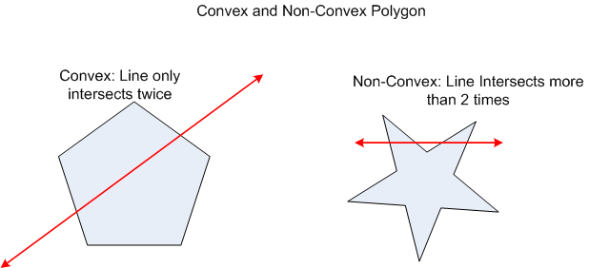
Convex and non-convex shapes

Slide 16
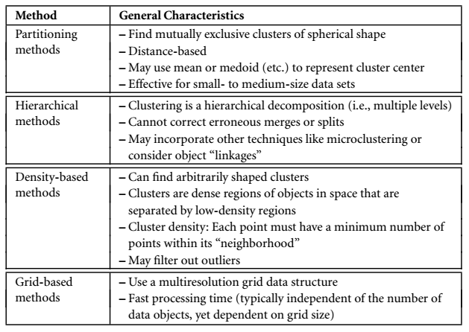
Major Clustering Approaches
See book Page no 448

Slide 17
Major Clustering Approaches (I)
Partitioning approach:
Construct various partitions and then evaluate them by some criterion, e.g., minimizing the sum of square errors
Typical methods: k-means, k-medoids, CLARANS
Hierarchical approach:
Create a hierarchical decomposition of the set of data (or objects) using some criterion
Typical methods: Diana, Agnes, BIRCH, CAMELEON
Density-based approach:
Based on connectivity and density functions
Typical methods: DBSACN, OPTICS, DenClue
Grid-based approach:
based on a multiple-level granularity structure
Typical methods: STING, WaveCluster, CLIQUE

Slide 18
Major Clustering Approaches (II)
Model-based:
A model is hypothesized for each of the clusters and tries to find the best fit of that model to each other
Typical methods: EM, SOM, COBWEB
Frequent pattern-based:
Based on the analysis of frequent patterns
Typical methods: p-Cluster
User-guided or constraint-based:
Clustering by considering user-specified or application-specific constraints
Typical methods: COD (obstacles), constrained clustering
Link-based clustering:
Objects are often linked together in various ways
Massive links can be used to cluster objects: SimRank, LinkClus

Slide 19
Chapter 10. Cluster Analysis: Basic Concepts and Methods
Cluster Analysis: Basic Concepts
Partitioning Methods
Hierarchical Methods
Density-Based Methods
Grid-Based Methods
Evaluation of Clustering
19
19
Notes:
19

Slide 20
Partitioning Algorithms: Basic Concept
Partitioning method: Partitioning a database D of n objects into a set of k clusters, such that the sum of squared distances is minimized (where c_{i} is the centroid or medoid of cluster C_{i}), p is point/object
Given k, find a partition of k clusters that optimizes the chosen partitioning criterion
Global optimal: exhaustively enumerate all partitions
Heuristic methods: k-means and k-medoids algorithms
k-means (MacQueen’67, Lloyd’57/’82): Each cluster is represented by the center of the cluster
k-medoids or PAM (Partition around medoids) (Kaufman & Rousseeuw’87): Each cluster is represented by one of the objects in the cluster

Slide 21
The K-Means Clustering Method
Given k, the k-means algorithm is implemented in four steps:
Partition objects into k nonempty subsets
Compute seed points as the centroids of the clusters of the current partitioning (the centroid is the center, i.e., mean point, of the cluster)
Assign each object to the cluster with the nearest seed point
Go back to Step 2, stop when the assignment does not change

Slide 22
An Example of K-Means Clustering
K=2
Arbitrarily partition objects into k groups
Update the cluster centroids
The initial data set
Loop if needed
Reassign objects
Partition objects into k nonempty subsets
Repeat
Compute centroid (i.e., mean point) for each partition
Assign each object to the cluster of its nearest centroid
Until no change
Update the cluster centroids

Slide 23
Comments on the K-Means Method
Strength: Efficient: O(tkn), where n is # objects, k is # clusters, and t is # iterations. Normally, k, t << n.
Comparing: PAM: O(k(n-k)² ), CLARA: O(ks² + k(n-k))
Comment: Often terminates at a local optimal.
Weakness
Applicable only to objects in a continuous n-dimensional space
Using the k-modes method for categorical data
In comparison, k-medoids can be applied to a wide range of data
Need to specify k, the number of clusters, in advance (there are ways to automatically determine the best k (see Hastie et al., 2009)
Sensitive to noisy data and outliers
Not suitable to discover clusters with non-convex shapes

Slide 24
Variations of the K-Means Method
Most of the variants of the k-means which differ in
Selection of the initial k means
Dissimilarity calculations
Strategies to calculate cluster means
Handling categorical data: k-modes
Replacing means of clusters with modes
Using new dissimilarity measures to deal with categorical objects
Using a frequency-based method to update modes of clusters
A mixture of categorical and numerical data: k-prototype method

Slide 25
What Is the Problem of the K-Means Method? (See book pane 454 example 10.2)
The k-means algorithm is sensitive to outliers !
Since an object with an extremely large value may substantially distort the distribution of the data
K-Medoids: Instead of taking the mean value of the object in a cluster as a reference point, medoids can be used, which is the most centrally located object in a cluster
10
10
9
9
8
8
7
7
6
6
5
5
4
4
3
3
2
2
1
1
0
0
1
2
3
4
5
6
7
8
9
10
0
0
1
2
3
4
5
6
7
8
9
10

Slide 26
PAM: A Typical K-Medoids Algorithm
Total Cost = 20
10
9
8
Arbitrary choose k object as initial medoids
Assign each remaining object to nearest medoids
7
6
5
4
3
2
1
0
0
1
2
3
4
5
6
7
8
9
10
K=2
Randomly select a nonmedoid object,O_{ramdom}
Total Cost = 26
Do loop
Until no change
10
10
9
Compute total cost of swapping
9
Swapping O and O_{ramdom}
If quality is improved.
8
8
7
7
6
6
5
5
4
4
3
3
2
2
1
1
0
0
1
2
3
4
5
6
7
8
9
10
0
0
1
2
3
4
5
6
7
8
9
10
26
Notes:
26

Slide 27
The K-Medoid Clustering Method
K-Medoids Clustering: Find representative objects (medoids) in clusters
PAM (Partitioning Around Medoids, Kaufmann & Rousseeuw 1987)
Starts from an initial set of medoids and iteratively replaces one of the medoids by one of the non-medoids if it improves the total distance of the resulting clustering
PAM works effectively for small data sets, but does not scale well for large data sets (due to the computational complexity)
Efficiency improvement on PAM
CLARA (Kaufmann & Rousseeuw, 1990): PAM on samples
CLARANS (Ng & Han, 1994): Randomized re-sampling

Slide 28
Chapter 10. Cluster Analysis: Basic Concepts and Methods
Cluster Analysis: Basic Concepts
Partitioning Methods
Hierarchical Methods
Density-Based Methods
Grid-Based Methods
Evaluation of Clustering
28
28
Notes:
28

Slide 29
Hierarchical Clustering
Use distance matrix as clustering criteria. This method does not require the number of clusters k as an input, but needs a termination condition
Step 0
Step 1
Step 2
Step 3
Step 4
agglomerative
(AGNES)
Bottom-up Approach
a
a b
b
a b c d e
c
c d e
d
d e
e
divisive
(DIANA)
Top-down approach
Step 4
Step 3
Step 2
Step 1
Step 0

Slide 30
Agglomerative versus Divisive Hierarchical Clustering
agglomerative hierarchical clustering method uses a bottom-up strategy.
starts by letting each object form its own cluster and iteratively merges clusters into larger and larger clusters, until all the objects are in a single cluster or certain termination conditions are satisfied.
A divisive hierarchical clustering method employs a top-down strategy.
It starts by placing all objects in one cluster, which is the hierarchy’s root. It then divides the root cluster into several smaller subclusters, and recursively partitions those clusters into smaller ones.
The partitioning process continues until each cluster at the lowest level is coherent enough—either containing only one object, or the objects within a cluster are sufficiently similar to each other.

Slide 31
AGNES (AGglomerative NESting)
Introduced in Kaufmann and Rousseeuw (1990)
Implemented in statistical packages, e.g., Splus
Use the single-link method and the dissimilarity matrix
Merge nodes that have the least dissimilarity
Go on in a non-descending fashion
Eventually all nodes belong to the same cluster

Slide 32
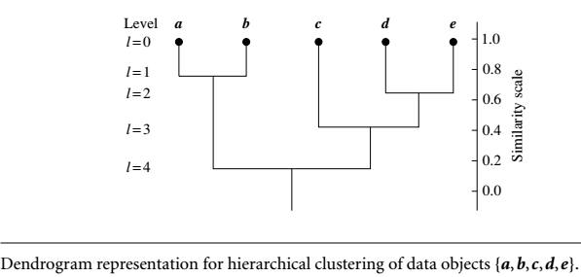
Dendrogram: Shows How Clusters are Merged
Decompose data objects into a several levels of nested partitioning (tree of clusters), called a dendrogram
A clustering of the data objects is obtained by cutting the dendrogram at the desired level, then each connected component forms a cluster

Slide 33
DIANA (Divisive Analysis)
Introduced in Kaufmann and Rousseeuw (1990)
Implemented in statistical analysis packages, e.g., Splus
Inverse order of AGNES
Eventually each node forms a cluster on its own

Slide 34
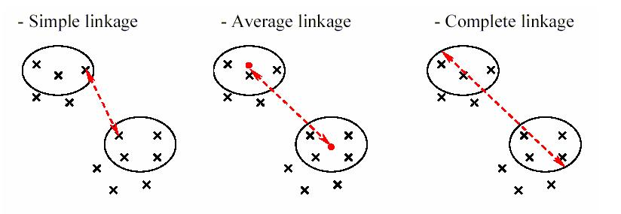
Distance between Clusters

Slide 35
Distance between Clusters
X
X
Single link: smallest distance between an element in one cluster and an element in the other, i.e., dist(K_{i}, K_{j}) = min(t_{ip}, t_{jq})
Complete link: largest distance between an element in one cluster and an element in the other, i.e., dist(K_{i}, K_{j}) = max(t_{ip}, t_{jq})
Average: avg distance between an element in one cluster and an element in the other, i.e., dist(K_{i}, K_{j}) = avg(t_{ip}, t_{jq})
Centroid: distance between the centroids of two clusters, i.e., dist(K_{i}, K_{j}) = dist(C_{i}, C_{j})
Medoid: distance between the medoids of two clusters, i.e., dist(K_{i}, K_{j}) = dist(M_{i}, M_{j})
Medoid: a chosen, centrally located object in the cluster
35
Notes:
35

Slide 36
Centroid, Radius and Diameter of a Cluster (for numerical data sets)
Centroid: the “middle” of a cluster
Radius: square root of average distance from any point of the cluster to its centroid
Diameter: square root of average mean squared distance between all pairs of points in the cluster
36
Notes:
36

Slide 37
Extensions to Hierarchical Clustering
Major weakness of agglomerative clustering methods
Can never undo what was done previously
Do not scale well: time complexity of at least O(n²), where n is the number of total objects
Integration of hierarchical & distance-based clustering
BIRCH (1996): uses CF-tree and incrementally adjusts the quality of sub-clusters
CHAMELEON (1999): hierarchical clustering using dynamic modeling

Slide 38
Chapter 10. Cluster Analysis: Basic Concepts and Methods
Cluster Analysis: Basic Concepts
Partitioning Methods
Hierarchical Methods
Density-Based Methods
Grid-Based Methods
Evaluation of Clustering
Summary
38
38
Notes:
38

Slide 39
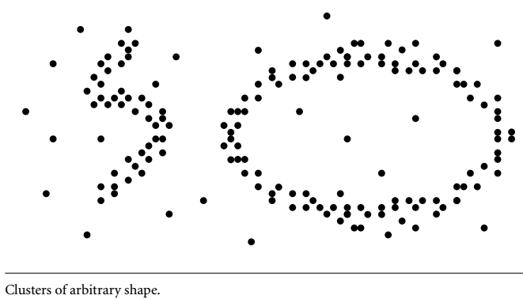
Density-Based Methods
Partitioning and hierarchical methods are designed to find spherical-shaped clusters.
They have difficulty finding clusters of arbitrary shape.
Strategy: To find clusters of arbitrary shape, alternatively, we can model clusters as dense regions in the data space, separated by sparse regions.

Slide 40
Density-Based Clustering Methods
Clustering based on density (local cluster criterion), such as density-connected points
Major features:
Discover clusters of arbitrary shape
Handle noise
One scan
Need density parameters as termination condition
Several interesting studies:
DBSCAN: Ester, et al. (KDD’96)
OPTICS: Ankerst, et al (SIGMOD’99).
DENCLUE: Hinneburg & D. Keim (KDD’98)
CLIQUE: Agrawal, et al. (SIGMOD’98) (more grid-based)

Slide 41
DBSCAN: Density-Based Clustering Based on Connected Regions with High Density
The density of an object o can be measured by the number of objects close to o.
DBSCAN (Density-Based Spatial Clustering of Applications with Noise) finds core objects, that is, objects that have dense neighborhoods.
It connects core objects and their neighborhoods to form dense regions as clusters.
User given parameter epsilon ε>0 is radius of neighborhood of an object centered at o.
Fixed size of neighborhood ε density can measured by number objects in it.
To determine density DBSCAN uses threshold of MinPts.
An object is a core object if the ε-neighborhood of the object contains at least MinPts objects.
We can assemble a large dense region using small dense regions centered by core objects?

Slide 42
Density-Based Clustering: Basic Concepts
Two parameters:
Epsilon (ε): Maximum radius of the neighbourhood
MinPts: Minimum number of points in an Eps-neighbourhood of that point
N_{Eps}(p): {q belongs to D | dist(p,q) ≤ Eps} called core object
Directly density-reachable: A point p is directly density-reachable from a point q w.r.t. Eps, MinPts if
p belongs to N_{Eps}(q)
core point condition:
|N_{Eps} (q)| ≥ MinPts
p
MinPts = 5
Eps = 1 cm
q

Slide 43
Density-Reachable and Density-Connected
Density-reachable:
A point p is density-reachable from a point q w.r.t. Eps, MinPts if there is a chain of points p₁, …, p_{n}, p₁ = q, p_{n} = p such that p_{i+1} is directly density-reachable from p_{i}
Density-connected
A point p is density-connected to a point q w.r.t. Eps, MinPts if there is a point o such that both, p and q are density-reachable from o w.r.t. Eps and MinPts
p
p₁
q
p
q
o

Slide 44
DBSCAN: Density-Based Spatial Clustering of Applications with Noise
Relies on a density-based notion of cluster: A cluster is defined as a maximal set of density-connected points
Discovers clusters of arbitrary shape in spatial databases with noise
Outlier
Border
Eps = 1cm
MinPts = 5
Core

Slide 45
DBSCAN: The Algorithm
Arbitrary select a point p
Retrieve all points density-reachable from p w.r.t. Eps and MinPts
If p is a core point, a cluster is formed
If p is a border point, no points are density-reachable from p and DBSCAN visits the next point of the database
Continue the process until all of the points have been processed

Slide 46
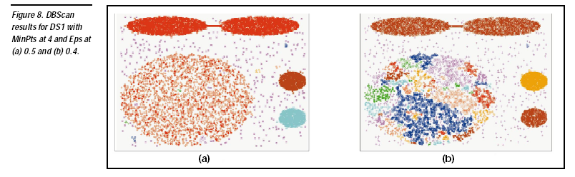

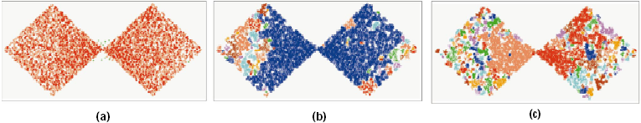
DBSCAN: Sensitive to Parameters

Slide 47
Chapter 10. Cluster Analysis: Basic Concepts and Methods
Cluster Analysis: Basic Concepts
Partitioning Methods
Hierarchical Methods
Density-Based Methods
Grid-Based Methods
Evaluation of Clustering
47
47
Notes:
47

Slide 48
Grid-Based Clustering Method
Using multi-resolution grid data structure
Several interesting methods
STING (a STatistical INformation Grid approach) by Wang, Yang and Muntz (1997)
WaveCluster by Sheikholeslami, Chatterjee, and Zhang (VLDB’98)
A multi-resolution clustering approach using wavelet method
CLIQUE: Agrawal, et al. (SIGMOD’98)
Both grid-based and subspace clustering

Slide 49
STING: A Statistical Information Grid Approach
Wang, Yang and Muntz (VLDB’97)
The spatial area is divided into rectangular cells
There are several levels of cells corresponding to different levels of resolution

Slide 50
The STING Clustering Method
Each cell at a high level is partitioned into a number of smaller cells in the next lower level
Statistical info of each cell is calculated and stored beforehand and is used to answer queries
Parameters of higher level cells can be easily calculated from parameters of lower level cell
count, mean, s, min, max
type of distribution—normal, uniform, etc.
Use a top-down approach to answer spatial data queries
Start from a pre-selected layer—typically with a small number of cells
For each cell in the current level compute the confidence interval

Slide 51
STING Algorithm and Its Analysis
Remove the irrelevant cells from further consideration
When finish examining the current layer, proceed to the next lower level
Repeat this process until the bottom layer is reached
Advantages:
Query-independent, easy to parallelize, incremental update
O(K), where K is the number of grid cells at the lowest level
Disadvantages:
All the cluster boundaries are either horizontal or vertical, and no diagonal boundary is detected

Slide 52
CLIQUE (Clustering In QUEst)
Agrawal, Gehrke, Gunopulos, Raghavan (SIGMOD’98)
Automatically identifying subspaces of a high dimensional data space that allow better clustering than original space
CLIQUE can be considered as both density-based and grid-based
It partitions each dimension into the same number of equal length interval
It partitions an m-dimensional data space into non-overlapping rectangular units
A unit is dense if the fraction of total data points contained in the unit exceeds the input model parameter
A cluster is a maximal set of connected dense units within a subspace
52
Notes:
52

Slide 53
CLIQUE: The Major Steps
Partition the data space and find the number of points that lie inside each cell of the partition.
Identify the subspaces that contain clusters using the Apriori principle
Identify clusters
Determine dense units in all subspaces of interests
Determine connected dense units in all subspaces of interests.
Generate minimal description for the clusters
Determine maximal regions that cover a cluster of connected dense units for each cluster
Determination of minimal cover for each cluster
53
Notes:
53

Slide 54
Salary (10,000)
Vacation(week)
7
7
6
6
5
5
4
4
3
3
2
2
1
1
0
age
0
age
20
30
40
50
60
20
30
40
50
60
τ = 3
Vacation
Salary
30
50
age
54
Notes:
54

Slide 55
Strength and Weakness of CLIQUE
Strength
automatically finds subspaces of the highest dimensionality such that high density clusters exist in those subspaces
insensitive to the order of records in input and does not presume some canonical data distribution
scales linearly with the size of input and has good scalability as the number of dimensions in the data increases
Weakness
The accuracy of the clustering result may be degraded at the expense of simplicity of the method
55
Notes:
55

Slide 56
Chapter 10. Cluster Analysis: Basic Concepts and Methods
Cluster Analysis: Basic Concepts
Partitioning Methods
Hierarchical Methods
Density-Based Methods
Grid-Based Methods
Evaluation of Clustering
56
56
Notes:
56

Slide 57
Assessing Clustering Tendency
57
Assess if non-random structure exists in the data by measuring the probability that the data is generated by a uniform data distribution
Test spatial randomness by statistic test: Hopkins Static
Given a dataset D regarded as a sample of a random variable o, determine how far away o is from being uniformly distributed in the data space
Sample n points, p₁, …, p_{n}, uniformly from D. For each p_{i}, find its nearest neighbor in D: x_{i} = min{dist (p_{i}, v)} where v in D
Sample n points, q₁, …, q_{n}, uniformly from D. For each q_{i}, find its nearest neighbor in D – {q_{i}}: y_{i} = min{dist (q_{i}, v)} where v in D and v ≠ q_{i}
Calculate the Hopkins Statistic:
If D is uniformly distributed, ∑ x_{i} and ∑ y_{i} will be close to each other and H is close to 0.5. If D is highly skewed, H is close to 0

Slide 58
Determine the Number of Clusters
Empirical method
# of clusters ≈√n/2 for a dataset of n points
Elbow method
Use the turning point in the curve of sum of within cluster variance w.r.t the # of clusters
Cross validation method
Divide a given data set into m parts
Use m – 1 parts to obtain a clustering model
Use the remaining part to test the quality of the clustering
E.g., For each point in the test set, find the closest centroid, and use the sum of squared distance between all points in the test set and the closest centroids to measure how well the model fits the test set
For any k > 0, repeat it m times, compare the overall quality measure w.r.t. different k’s, and find # of clusters that fits the data the best
58

Slide 59
Measuring Clustering Quality
Two methods: extrinsic vs. intrinsic
Extrinsic: supervised, i.e., the ground truth is available
Compare a clustering against the ground truth using certain clustering quality measure
Ex. BCubed precision and recall metrics
Intrinsic: unsupervised, i.e., the ground truth is unavailable
Evaluate the goodness of a clustering by considering how well the clusters are separated, and how compact the clusters are
Ex. Silhouette coefficient
59

Slide 60
Measuring Clustering Quality: Extrinsic Methods
60
Clustering quality measure: Q(C, C_{g}), for a clustering C given the ground truth C_{g}.
Q is good if it satisfies the following 4 essential criteria
Cluster homogeneity: the purer, the better
Cluster completeness: should assign objects belong to the same category in the ground truth to the same cluster
Rag bag: putting a heterogeneous object into a pure cluster should be penalized more than putting it into a rag bag (i.e., “miscellaneous” or “other” category)
Small cluster preservation: splitting a small category into pieces is more harmful than splitting a large category into pieces

